Slide 1
AUTOMOBILES SALES ANALYSIS
NAME: HAREESH A
REGISTER NO: 312207288
DEPARTMENT: COMMERCE
COLLEGE: CKNC

Slide 2
AUTOMOBILES SALES ANALYSIS BY USING MICRO SOFT EXCEL

Slide 3
AGENDA
Problem statement
Project overview
Identify key sales drivers
Analyze sales trends
Forecast sales
Result
Conclusion

Slide 4
PROBLEM STATEMENT
The automobiles industry is highly competitive and influenced by various factors such as economic conditions, consumer preferences, and technologies and advancements. Despite the potential for growth, many automobiles companies face challenges in predicting sales trends, identifying key drivers of sales, and making date-driven decisions to optimize inventory, pricing and marketing.

Slide 5
PROJECT OVERVIEW
our project aims to analyse the overall sales of cars in automobiles industry.
We seek accurately the sales ration of the automobiles industry.
The excel will expose the sales ration of the cars.

Slide 6
IDENTIFY KEY SALES DRIVERS
Economic factors
Consumer preferences
Market trends
Competitive dynamics
Regulatory & policy factors
Technological advances

Slide 7
ANALYZE SALES TRENDS
Understand historical sales trends across different regions, time periods, and vehicle categories to predict future sales performance. Here’s how you can approach the analysis:
Time series analysis
Segment-wise analysis
Economic impact
Consumer landscape
Consumer behaviour trends
Competitive landscape
Regulatory and policy changes
Pandemic impact

Slide 8
FORECAST SALES
Develop predictive models to forecast future sales based on historical data and market conditions

Slide 9
REASON FOR HIGH SALES
GLOBAL AVAILABILITY: the Toyota corolla is sold in over 150 countries, making it widely accessible.
Affordability: it is positioned as the reliable and affordable vehicle for the average consumer.

Slide 10
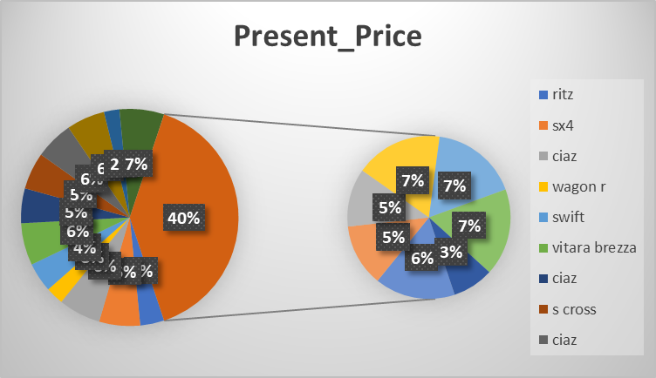
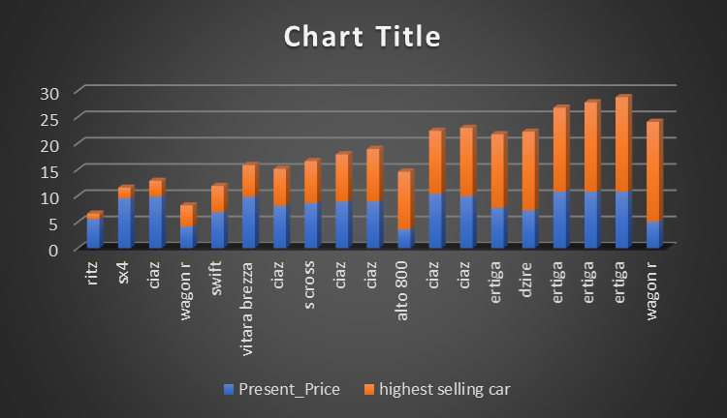
RESULT

Slide 11
CONCLUSION
By analysing these sales trend, companies can gain valuable insights into market dynamics, allowing them to make informed decisions on inventory management, market strategies, product development, and overall business planning.

Slide 12
THANK YOU!

